Slide 1
Voice Recognition and Pokémon™
By Supratik Chanda and Chris Higgs

Slide 2
Gender Voice Recognition Introduction and Dataset
Gender Recognition by Voice and Speech Analysis
The dataset consists of 3,168 recorded voice samples, collected from male and female speakers
The voice samples are pre-processed by acoustic analysis in R using the seewave and tuneR packages, with an analyzed frequency range of 0hz-280hz (human vocal range).
The acoustic properties of each voice are measured and included within the CSV

Slide 3

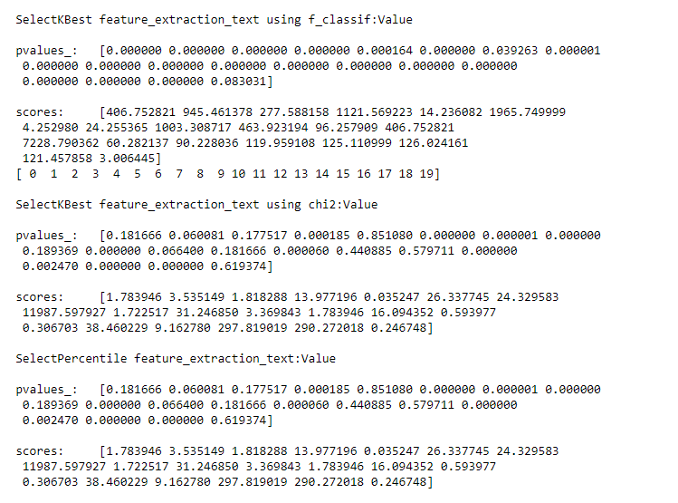
Analysis Technique: Feature Selection of Dependent Variables
Two Feature selection packages have been used:
SelectKBest
SelectPercentile
Two score_functions have been used:
chi2
f_Classif
Top 10 features is extracted depending on score or p values

Slide 4

Determination of a Grid Search Approach which takes least execution time.
GridSearchCV Parameters
RandomizedSearchCV Parameters

Slide 5
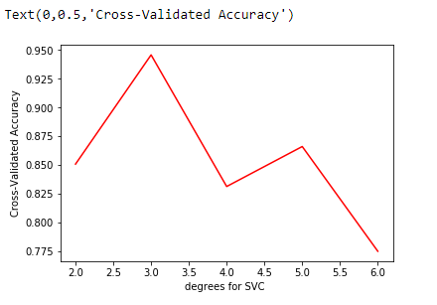
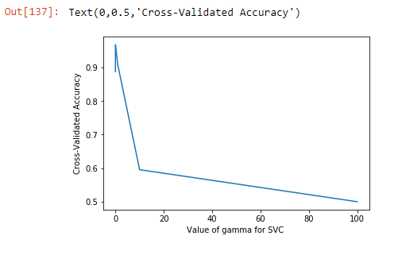
General Approach to find best parameters for SVM.
SVM RBF( Analyzing different values of gamma parameter for generalization).
SVM Poly(Analyzing different values of degree parameter).

Slide 6
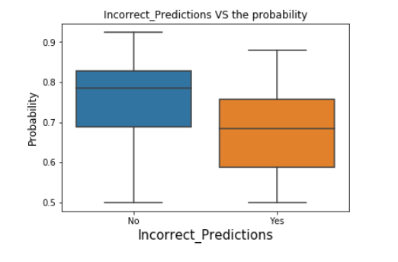
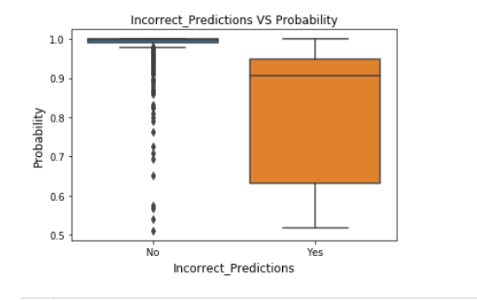
Probability of Predicted Labels: Male / Female
SVM RBF
SVM POLY

Slide 7
Pokémon™ Introduction & Dataset
Elemental Type Parallels Biological Taxonomy
Predict Elemental Type from Measurements and Observations
“The Complete Pokemon Dataset” – Kaggle
“Pokemon for Data Mining and Machine Learning” – Kaggle
Stats for 721 Species
Merging Stat Values
Boolean Classification Attributes (28 New)

Slide 8
Pokémon™ Analysis Technique
Custom Taxonomy Matrices
Logistic Regression (OVR-like Approach)
SVM (Linear, Polynomial, and RBF Kerneling)
Comparing Stat Subsets’ Predictiveness

Slide 9
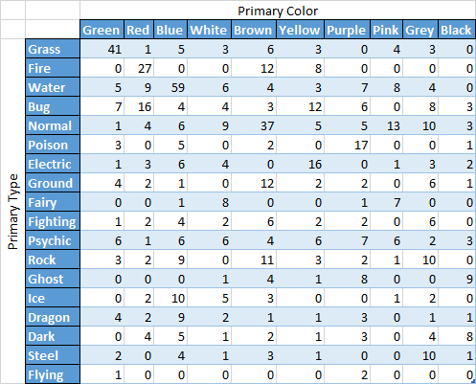
Pokémon™ Results
Green >>> Grass;
Black -> Ghost, Dark
What Does “Type” Really Mean?
Dragon Vs. Flying (Subset?)
Ground Vs Rock (Equivalence?)

Slide 10
Pokémon™ Results Cont.
Logistic Regression (OVR-like)
Typical Stats, Atypical Stats, & Color: Extremely Poor
Ag_* Stats: Average F1 = 0.842 (Secondary Types, Intra-type Correlations)
SVM (Linear & Polynomial) - Most: Non-Convergent
SVM (RBF, gamma=0.1 best)
Typical Stats: Average F1 = 0.99 (Clustering Equivalent?)
Color: Average F1 = 0.32 (Surprisingly Poor)
Ag_* Stats: Average F1 = 0.95 (Clustering?)

Slide 11
Questions?

